Slide 1
2026 SYBA Coaches Meeting

Slide 2
Goals of a Coach in the SYBA
Teach/Develop players skills
  Skills over wins
Teach how to handle adversity
  How do your players deal with failure
  Baseball is a game of failure
Teach players to work together
  How do the kids work together and communicate with each other
Keep kids coming back each year!
  Create an experience that players want to come back to each year

Slide 3
Schedule
What does a good schedule look like?
2 practices per week minimum
2 league games
4-5 tournaments (SYBA will have a budget for each team, fundraise for extra)

Slide 4
Playing time
7-12 Year Olds
All players should play every game
Players should move positions every 2-3 innings
Players should have 2 positions they play consistently, your better athletes will have more, they should not be on the same side of the field
Develop pitchers, every player should pitch at minimum of 5 innings a year! ( 5-8 pitchers per team is the goal)
Catchers 2-3 each team
13-14 Year Olds
Players should all be playing every game, playing time starts to get separated by ability and engagement at practice
Starting to put a precedence on being competitive but player development is still the emphasis
5-7 pitchers per team and 2-3 catchers, use league games to develop!!!

Slide 5
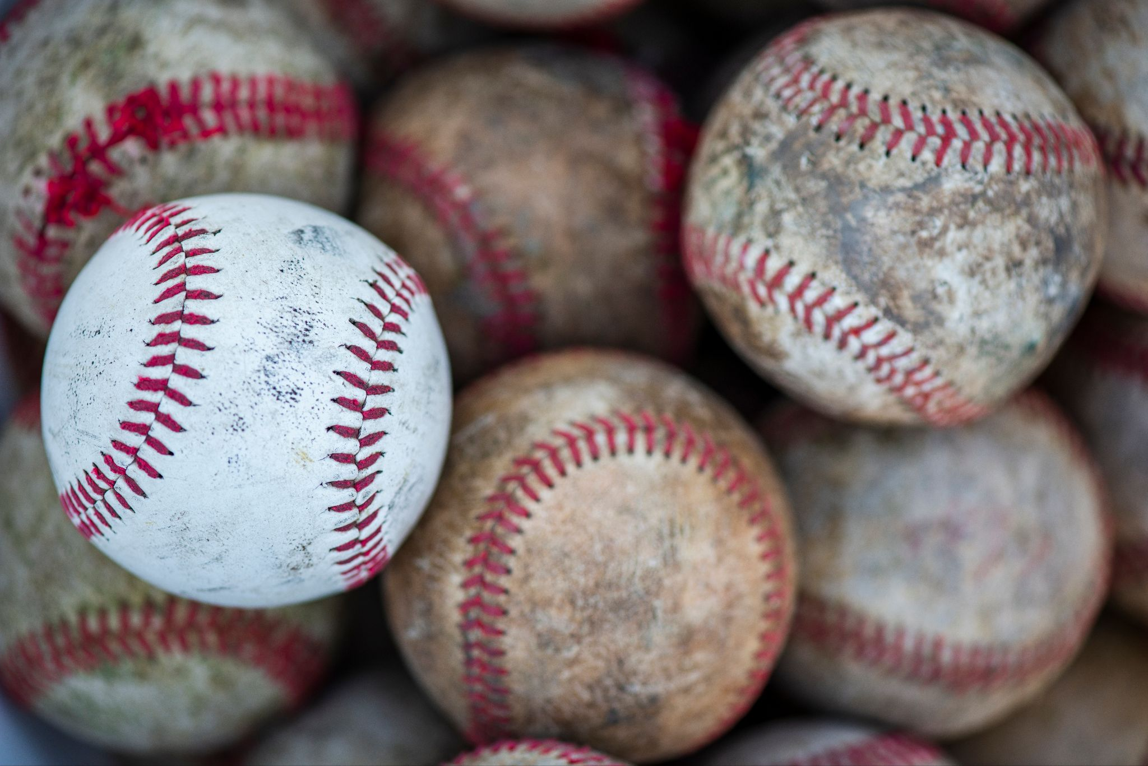
Skills are built in practice
Things that should be done every practice:
Players should throw and review proper throwing techniques
  Distance and amount may change per practice but kids need to throw
Individual Skills
  Infield, outfield, catchers all should have some time to individually get better
Hitting/Swings
  THIS DOESN’T HAVE TO BE LIVE ARM, utilize space and other options
  BE EFFICIENT
Base running
  Doesn’t mean get a line at home and run
  Work on leads, work on going 1st to 3rd or 2nd to home

Slide 6
Keys to an effective Practice
Have a plan!
  Doesn’t have to be typed out but must have a plan
Focus on the small details everyday
  Work on the gaps in a kids skill set, what do they do well and what do we need to help them with
Master Routine Skills
  Fundamental skills (basic fielding position, throwing techniques, base running, outfield play)
Stay on Schedule
  If a drill is set for 10 min and it isn’t going well move on
Have goals and talk to your players before practice about the plan
  Players want to know what they need to do and how its going to help them
Be engaged
  Easy to get together and sit there and talk, focus on the kids
HAVE FUN
3/18/2023 Practice Plan
4/10/2024 Practice Plan
5/10 Practice Plan 3:30-5:30

Slide 7
Pitcher Keys
Balance and Coil
  Get your body to a balanced position and coil to explode
Throw fastballs for strikes
  All players have to be able to throw a fastball for a strike
Take time to work with pitchers on mechanics and pitch grip
Attack Hitters (Link)
Have something your tracking strike percentage and share with player/parent after game
  Tool for helping diffuse conflict when parents ask “why cant/doesn’t ______ pitch more”
  Helps kids understand the value of throwing strikes
Take time during Throwing routine to go over pitching
  Pitching does not have to be guys on a mound with a catcher, every kid can go throw basic wind up or stretch and throw to their partner

Slide 8
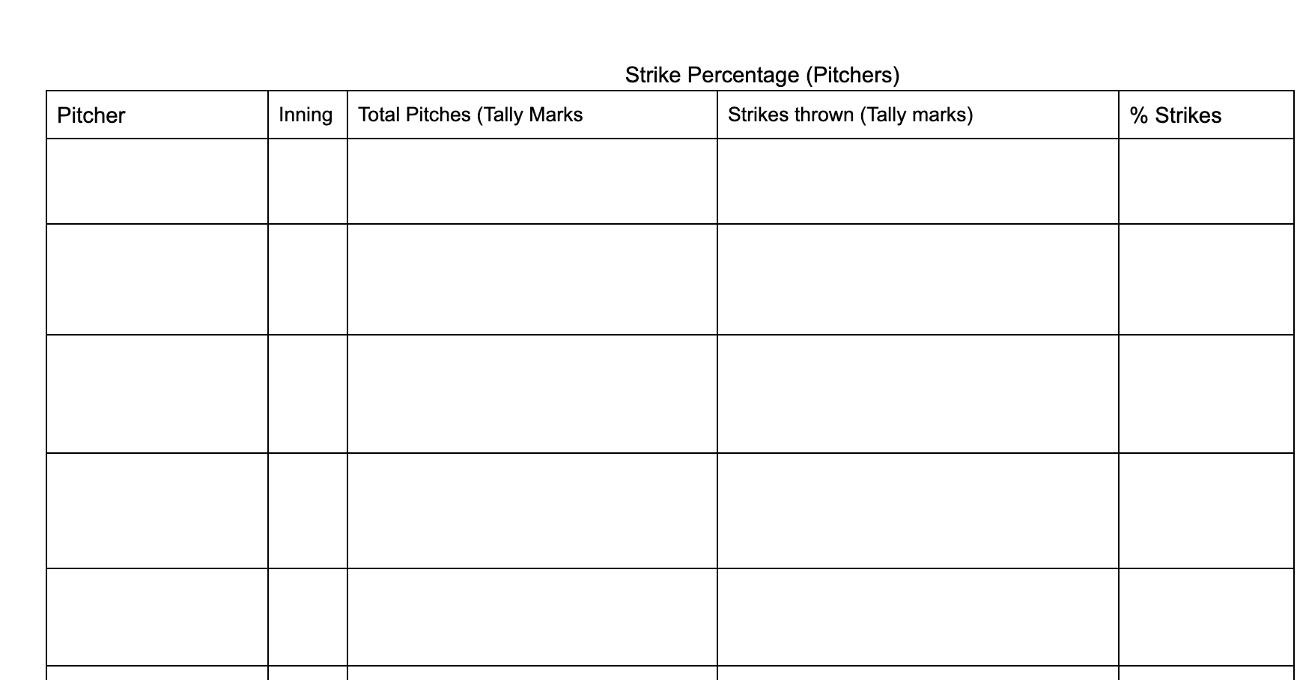

Slide 9
Hitting Keys
LOAD THE BODY
  No matter how old players have to learn how to load their body, through working with many of them in the off season many of them don’t know or don’t move their body into a load
  Easy way to teach it is give them a scenario they know, throwing a punch at their brother
Get the front foot down with hands back and head in the center of their body
  In in an athletic position ready to “deliver that punch”
Be on time for the fastball
  Get your front foot down on time for the pitchers best pitch
  How do players hit a curveball? Don’t miss the fastball in the zone. If a kid can spin 3 curveballs in a row for strikes tip your cap, odds are they can’t
Hips then hands
  Hips should fire then hands start, hands will always catch up

Slide 10
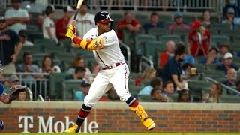
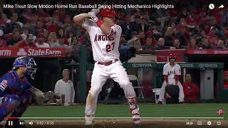
Aaron Judge
Ronald Acuna Jr.
Back side can do different things, elite hitters we are seeing do more of a push movement (even all the way back to Babe Ruth), some are more traditional turners. Find what works for your hitters, be adaptable.

Slide 11
My favorite Hitting drills
Step back Drill
Load, Stride, Fire
Carlos Correa PVC Pipe Drill
Split grip (focus on bat path w/top hand)

Slide 12
Infield Keys
Pre step movement
  Hop over step into it
6 F’s of fielding
  Feet (on toes, shoulder width apart)
  Field (Eyes to glove to bal)
  Funnel (Get glove and ball to common spot)
  Footwork (Right, Left)
  Fire (Get rid of the ball)
  Follow (follow your through)
Be Athletic
  Be able to make plays and it starts with being on your toes
INFIELD DRILLS DO NOT NEED TO BE STANDING IN A LINE AT SS AND COACHES HITTING GROUND BALLS AT EVERYONE, break down the skill and then rep it

Slide 13
My favorite infield drills
Circle Drill
USC Drill
Juan Uribe Cone Drill
Speed Ladder Drills

Slide 14
Outfield Keys
Pre step movement
  Be walking into stance as pitch is delivered
  Think first 3 steps after contact is the most important
Track Hitters Swing
  Be engaged with the hitter and react to ball off the bat
HIT CUT OFFS!
  Univ. of Minnesota throws to the cut off man 97% of the time!

Slide 15
My favorite Outfield drills
Over the shoulder
“Target” Practice
We set buckets at 2nd 3rd and home and tell our OF to hit the bucket

Slide 16

Drill Library

Slide 17
Player Communication
Communication with all people involved is important!
Positive communication
  After a win say very little, after a loss say even less. Kids don’t listen after a loss, they are beating themselves up you don’t have to
  Praise the positives!!!! You will get more out of them if you are promoting what is positive
Communicate with parents
  What do you need from them? Practice times, game day arrival, is practice canceled is it still on when there is bad weather? Parents want to know what is going on.
Dealing with a frustrated or angry parent
  Abide by the 24 hour rule
  Avoid text/email, try and do it face to face and with another adult
  Listen more than you speak
  Don’t try and argue, they aren’t listening to you anyways
  Don’t make promises you can’t keep! If you tell parents you are going to play little Johnny more you better be able to do that

Slide 18
Communication
Cuts
Person at the base is in control, and communicating
Make sure players are being specific when they are lining up the cut man
  Left 3 right 2 etc.
  Not just left left left
Person at the bag is reading the throw and communicating what he wants to happen by saying:
  Nothing then ball is not cut and comes to the bag (good to above average throw)
  Cut Hold (Ball is cut and cut off man turns and locates the runners, running the ball in)
  Cut Base (ball is cut off and thrown to the base called)
    Cut 2, cut 3, cut 4

Slide 19
Communication
Who cuts where:
We all know SS and 2nd are traditional cut off men, 8-11 use them for every base
  Generally our SS and MIF are our best athletes and have the best arms put the ball in their hands often
12-14U
  Arms and players are starting to grow and fields get bigger faster!
  3rd and 1st should be the primary cut to home with SS and 2nd being the double cut
  SS is the lead cut to 3rd from any OF position
    We use our SS to cut to 3rd from RF, 2nd can still be the lead cut man if its in a gap or down the line but we want our SS in a position to cut the ball as much as possible

Slide 20
Communication
Fly Balls
Every fly ball needs to be called
Players even at 8U should know priority
  OF over INF, CF over Corners, MIF over Corners, Corners over Catcher
Mine Mine Mine vs Ball Ball Ball
  We always say it 3 times no matter what
  Ball Ball Ball means I think I can get it
  Mine Mine Mine means I am camped out under it

Slide 21


Slide 22
Have a great season have fun! Reach out if you need anything, I want to be involved!

